Slide 1
A New Look at Genetic Evaluation
John B. Cole, Ph.D.
PEAK Senior VP of Research & Development
April 21, 2022

Slide 2
Outline
What problem are we trying to solve?
Can we solve that problem with genetic evaluations?
How might we do that?
Is there a better way to solve the problem?

Slide 3
There’s a race to find high bulls
AI breeds bulls to meet market demands
High-genetic-merit bulls have high marketability
Lower inbreeding rates result in slower genetic gains
Who’s willing to go slower to better manage inbreeding?
Source: Wikimedia Commons.

Slide 4
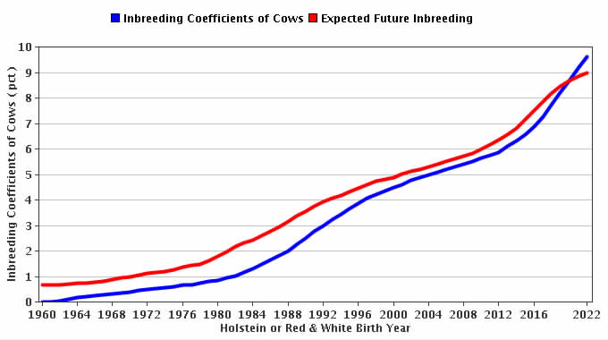
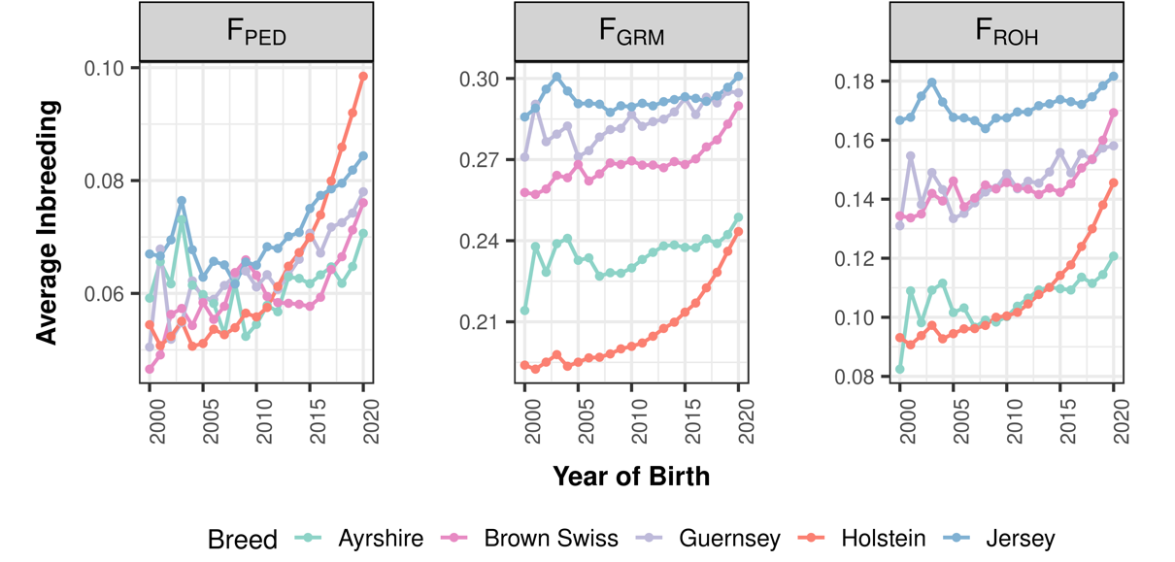
Where are we today?
Source: Lozada-Soto et al. (in review).
Source: Council on Dairy Cattle Breeding.

Slide 5
Should we worry about inbreeding?
Change in phenotypic performance per 1% (0.25%) increase in inbreeding
Milk | Fat | Protein | PL | SCS | DPR | HCR | CCR | LIV
-72.4 | -2.66 | -2.08 | -0.28 | 0.01 | -0.20 | -0.21 | -0.29 | -0.10
-18.1 | -0.67 | -0.52 | -0.07 | 0.025 | -0.05 | -0.05 | -0.07 | -0.025
Source: CDCB (https://queries.uscdcb.com/eval/summary/Bmean_bases_het.cfm).
Change in genetic potential per year when selecting on NM$
Milk | Fat | Protein | PL | SCS | DPR | HCR | CCR | LIV
+126.9 | +7.7 | +4.4 | +0.49 | -0.02 | +0.03 | +0.15 | +0.15 | +0.25
Source: AGIL, ARS, USDA (https://www.ars.usda.gov/ARSUserFiles/80420530/Publications/ARR/nmcalc-2021_ARR-NM8.pdf).

Slide 6
Are we concerned about the wrong thing?
“Selection, however - in marked contrast to its effectiveness in changing average merit - is a very feeble tool for changing homozygosity, except under the very simplest genetic situations…” (Lush, 1945)
“When the pure breeds finally reach equilibrium between the production of heterozygosis by mutations and the loss of heterozygosis because the effective number of animals in the breed is small, it is possible that the pure breed may support only a few scores of unfixed loci.” (Lush, 1945)

Slide 7
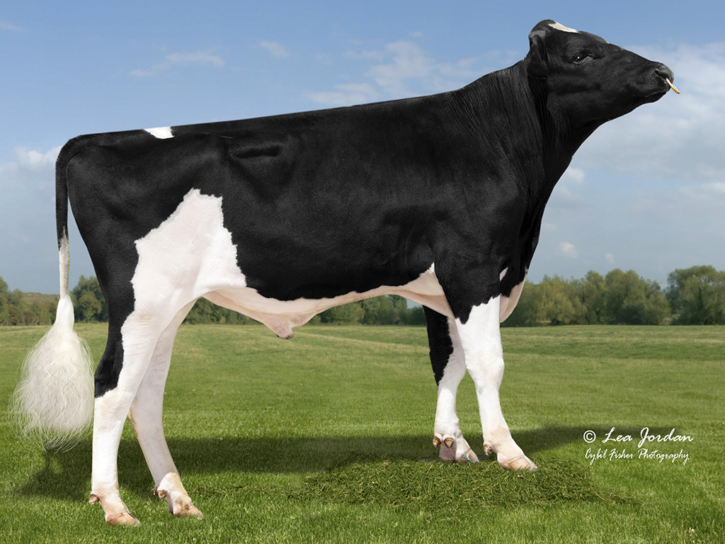
Proposed – Continue with PTA adjustments
Penalize bulls whose daughters are more related than average to the breed
This is already done in the US
Use genomic rather than pedigree inbreeding
Recently changed in US
Should we limit active bulls from the same sire family?
What about embryo donors?
Source: Alta Genetics.

Slide 8
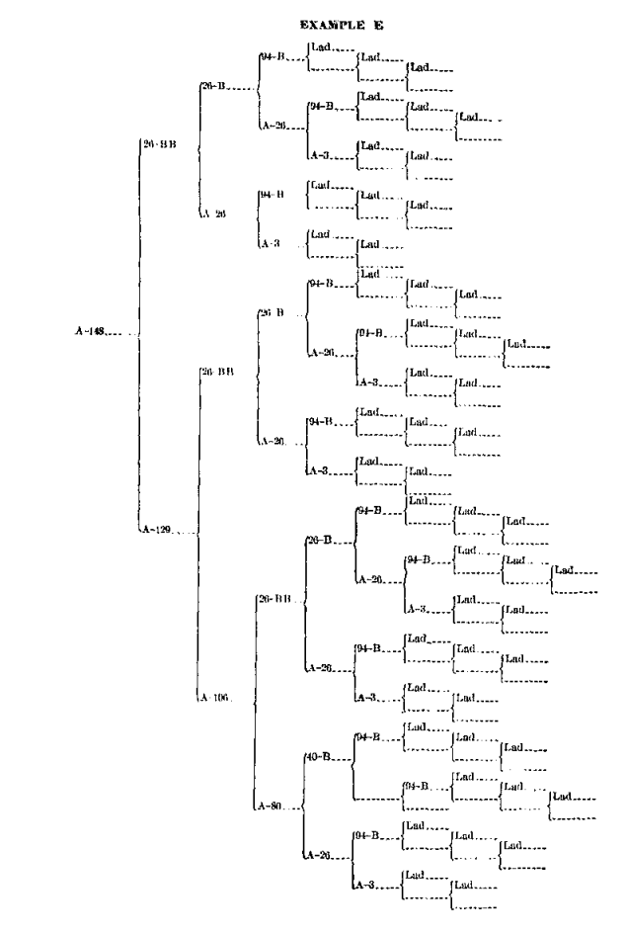
Proposed – Trim pedigrees?
Inbreeding melts away with the touch of a button!
Reflects the biological reality that recent inbreeding is more problematic than old inbreeding
Some countries already do this
Italy – 4 generations
Slovak Republic – 3 generations
UK – 5 generations
Some countries have more recent “founder” years

Slide 9
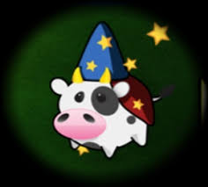
Proposed – No PTA published?
To avoid overuse of bulls, no PTA will be published
Bulls will be mated at random to the cow population
Or, bulls can receive “red”, “yellow”, or “green” badges for each trait to indicate quality
Or, only the mate selection software knows the PTA

Slide 10
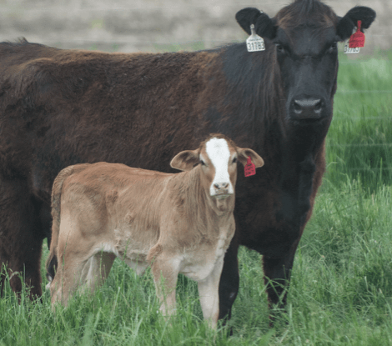
Proposed – Terminal dairy embryos?
Instead of selling semen to farmers, we could sell only embryos that represent the ideal terminal dairy cross
Each company will have its own dairy cross
There would be no inbreeding!
Who will maintain the purebred lines needed for this program?
How expensive could that really be?

Slide 11
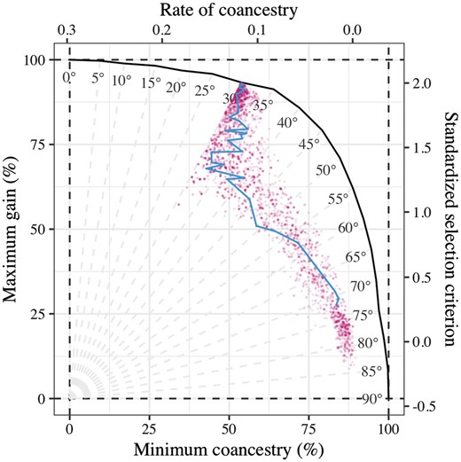
Proposed – Change the index?
Add some measure of genetic diversity to selection indices
A possible opportunity to use subpopulation membership
Isn’t this just a less-efficient way of implementing optimal contribution theory, which we’ve all been carefully ignoring?

Slide 12
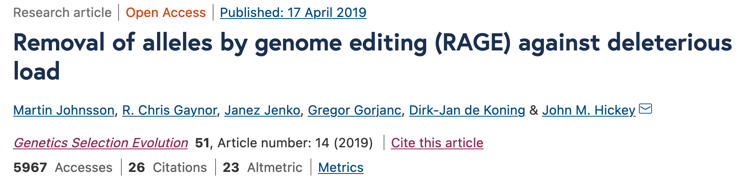
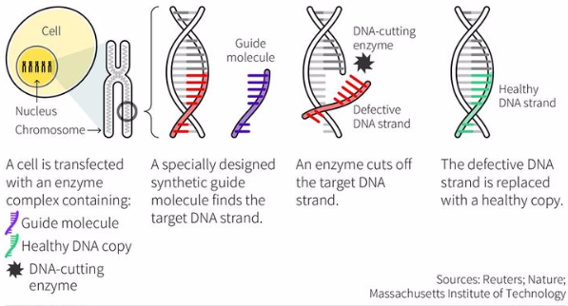
Proposed – Gene editing?
What if we just use gene editing to “fix” defects when we find them?
You only lose a few months with surrogate sires!
Then we can get rapid genetic gain without negative consequences!
Do we know where in the genome it’s important to have diversity, and where not?

Slide 13
I can’t be serious about this, can I?
Genetic evaluation is a tool for ranking animals for selection, not managing genetic diversity
We can manipulate the system to favor “outcross” animals, if we can find them, and penalize “inbred” animals
Such post hoc adjustments lack theoretical justification and can’t achieve what we want them to
Would we rather pretend that we’re doing things, or make changes that will have real impacts?
I showed examples of the former above
The latter will be discussed below

Slide 14
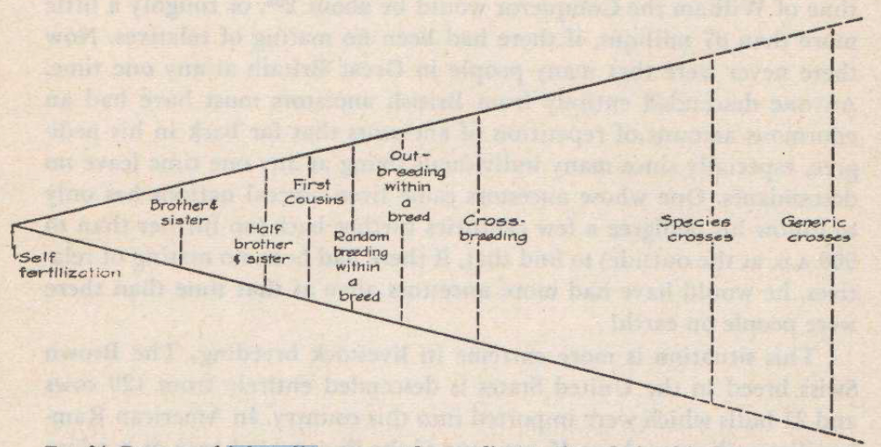
The future – Outcrossing between studs
AIs are becoming different sub-populations within breeds because of genetic protection programs
Will this lead to rotational breeding from each stud in turn?
How much difference should we expect if we’re all using similar breeding objectives?
Source: Lush (1945).

Slide 15
Do we have Holstein outcrosses today?
Group | Pedigree Inbreeding of Bull | Inbreeding of Past Daughters | Expected Future Inbreeding | Genomic Inbreeding of Bull | Genomic Future Inbreeding
Outcross | 9.17 | - | 9.12 | 12.15 | 10.30
Highly related | 9.78 | 4.39 | 10.86 | 10.63 | 11.17
Difference (Outcross-Highly related) | -0.61 | - | -1.74 | 1.52 | -0.87
Source: Council on Dairy Cattle Breeding.

Slide 16
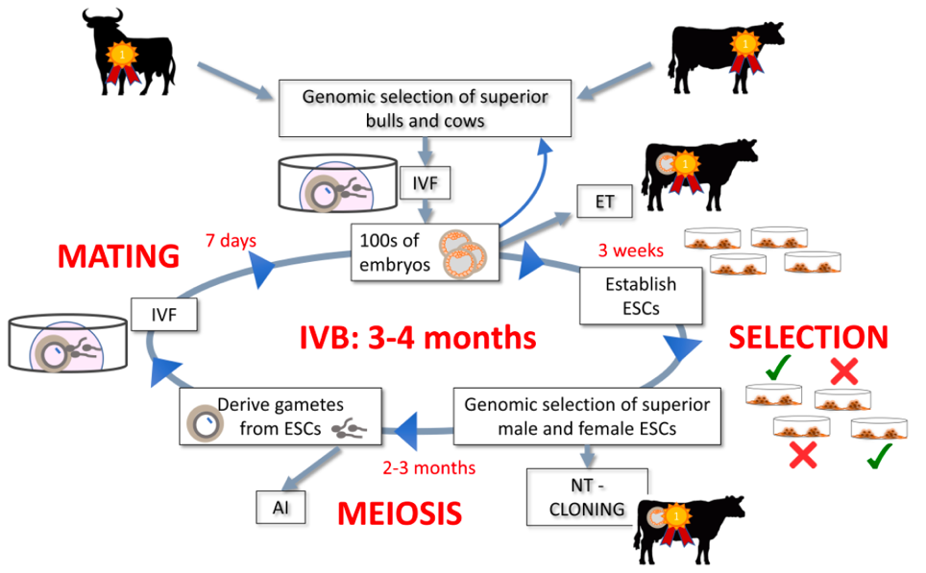
The future – In vitro breeding
Embryonic stem cells can be turned into sperm and eggs and used to create a new generation of embryos (Goszczynski et al., 2018, PMID: 30551176)
Faster genetic gain because time needed to create next generation is shortened
Live animals eventually needed

Slide 17
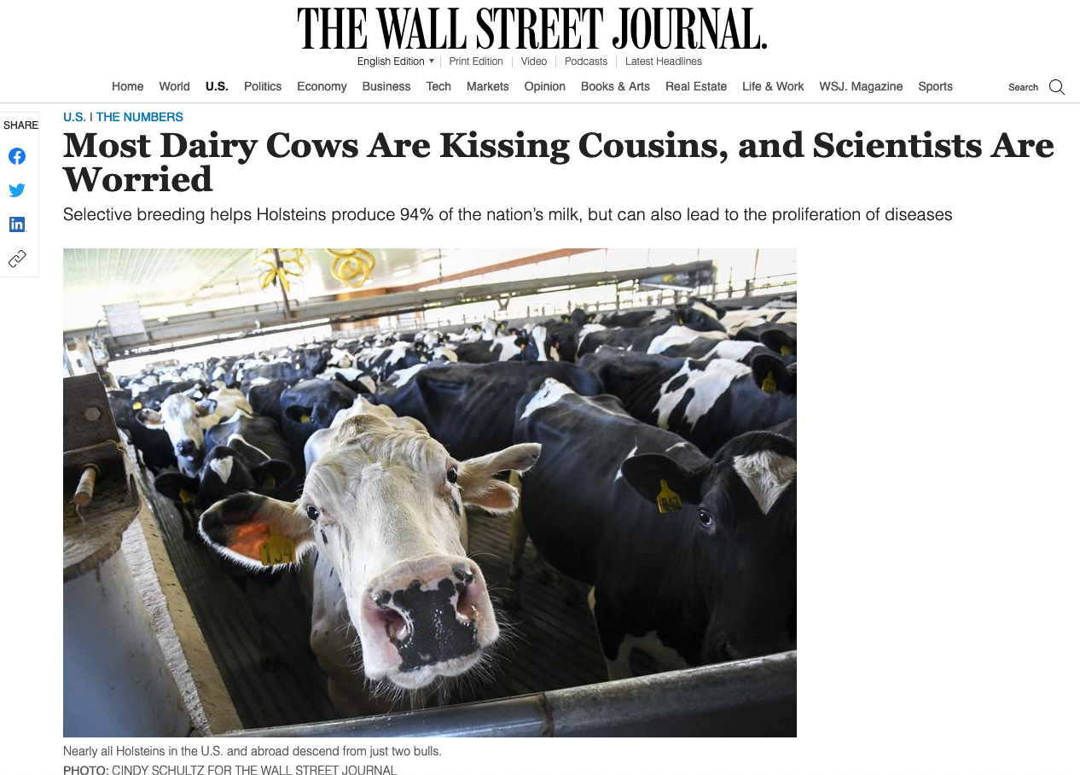
The future – License to operate?
Inbreeding may be important because of its impact on social license, not its impacts on production economics
Most people don’t understand the difference between strict selection on performance and no selection on performance
How will we educate the public?
What will consumers demand?

Slide 18
Are there better solutions to this problem?
There are many theoretically satisfying ideas…
…but nobody uses them
Geneticists and AI staff don’t breed cows, farmers do
Many cows now mated at random to a portfolio of bulls
Everyone thinks their neighbor should use different bulls
Some methods for avoiding inbreeding
Optimal contribution theory
Minimization of progeny inbreeding
Linear programming
Look-ahead mate selection
Selection against lethal alleles
Index selection including Mendelian sampling variance
Genomic selection including dominance

Slide 19
Big and small farms need different things
Small farms can afford to spend more time on each cow
Labor costs make that impractical for large farms
If a task takes an additional 30 seconds/cow and you’ve got 500 cows to breed in a day, that’s an extra 250 minutes of labor that’s needed
Sensors can’t (yet) put semen in a cow

Slide 20
Closing thoughts
Homozygosity is bad when there’s inbreeding depression
We may have evidence of some inbreeding depression for fertility traits, or we may not be doing a good job of finding the outliers
Increased genetic load compromises an animal’s adaptability
This is a concern as the climate changes and we seek to expand animal production in more challenging parts of the world
When there is tight control throughout the production chain (as in pork and poultry breeding) genetic diversity can be managed effectively
Dairy is a loosely coupled system where that control is lacking, and outcrossing is the logical consequence

Slide 21
Conclusions
We’re faced with increasingly complex problems (Baldassarre, 2020), and there are no easy answers
It’s important that we correctly identify the problems that need to be solved
Solutions will require the participation of many stakeholders in a complicated system
Achieving the necessary buy-in will require solid, objective evidence of an actual problem and a tangible solution to that problem

Slide 22


Conclusions
The world around us is changing so we need to change, too
The cow of the future will need to do more with less
We have very powerful tools for creating those cows
Social license will become even more important
Questions?

